Slide 1
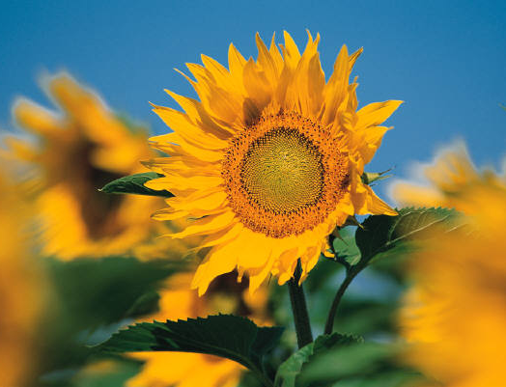
Shaping Literature Building
Lit in Life
The spark the fireworks
The Tweens or Children Club
Lit! in Translation (Literature Lives…)
Cultures thru time

Slide 2

Roots to know our ground
Wings to navigate through Life’s Climates
The Science as well as An Art

Slide 3


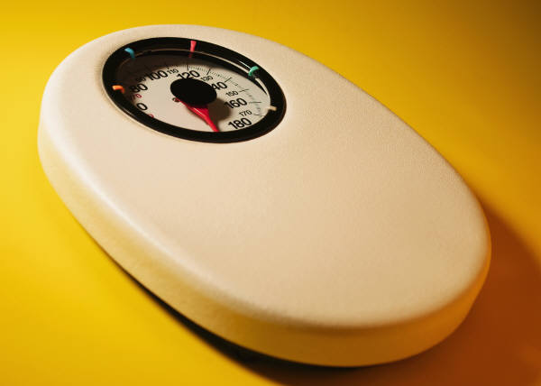
Expressiveness an art…
Literature IN Translation

Slide 4
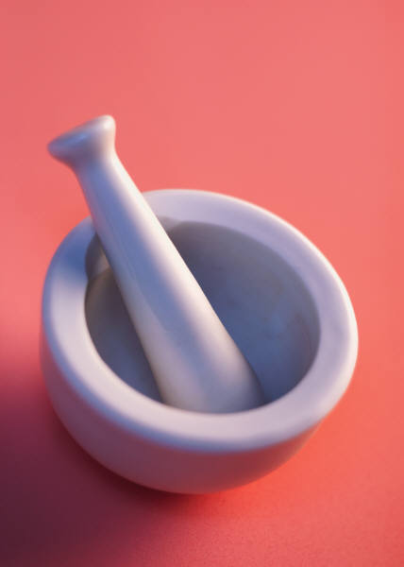
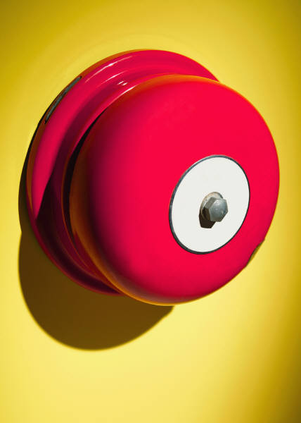
Finding ourselves under a canopy filled with stars
Finding oneself amongst other stars

Slide 5
