Slide 1
Charting a Course
The SOCIAL FABRIC

Slide 2
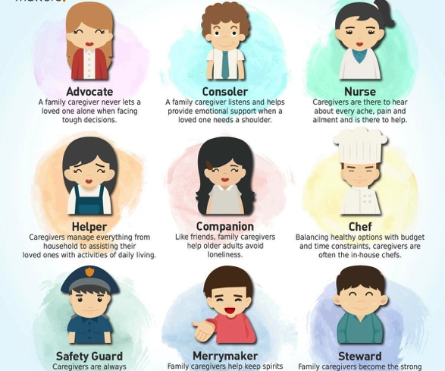
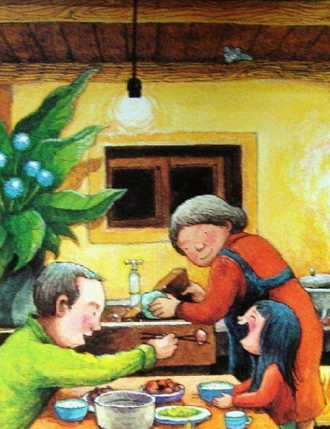
Map in hand
Plan Your journey
May go by the lakes natural scenic spots
Detours
Pump fuel the energy by the freeway
Your choice
Similar destination different paths
The calibration the humidity
Jolene Chan
Psychologist
Le Vive, SG.

Slide 3
Aims
Of
The Social Fabric
Identifying our personality
Acknowledging our needs
Relating with Our Family
Belonging with Our Community
Everyone!
We R ToGether

Slide 4
Individual
Society
Family
Friends
Colleagues
Acquaintances
Community

Slide 5
Personal Goals
Enriched Living
Goal Identification
(in relation to our personalities)
Reviewing Steps
(in relation to our development)
Ego
Pride
Nurturing
Dignity
Maturity
Growth
Sincerity (Care)
Responsibility

Slide 6
Mapping the Route to Your Destination…
The Life Cycle
Infant
Toddler
Grade Schooler
Teenager
Adolescent
Maturity
Visiting many venues,
finding the window to our favorite journeys
Birth…
Life is a Journey…
Sharing our journeys in life
Every person’s journey is a personal story where we share our Voices
Notes:
Sharing our journeys in life
Every person’s journey is a personal story where we share our Voices

Slide 7
Achieving equilibrium
Our Experiences
Growth
Balance
Development
Investment
LOW
HIGH
REWARDs
Growth
Equilibrium
Maturity

Slide 8
Hierarchy of Needs
Accumulation
Maslow’s
Self Actualization
Self-Esteem
Love & Belonging
Safety
Physiological
Notes:
Maslow’s Hierarchy of Needs

Slide 9
Your Buckets…
Bucket Approach
Formal Training
Growth
Education
Foundation
Responsibilities
Maturity with Community Development

Slide 10
Our personal assets
Reflecting Your Journeys
Self Development
Relating with Others
Contributing to Our Society

Slide 11
Personality development

Slide 12

in collaboration with you
empowered lives
Individuals living & belonging in a community
  Enriching journeys

